Slide 1
CSE 4128 Lab 3
Instructors:
Dr. Sk. Md. Masudul Ahsan Professor,
Dept. of Computer Science and Engineering, KUET
Mr. Sunanda Das
Assistant Professor,
Dept. of Computer Science and Engineering, KUET

Slide 2
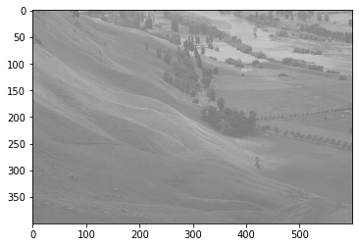
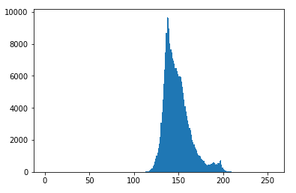
import cv2
import matplotlib.pyplot as plt
#image read … …
plt.hist(img.ravel(),256,[0,256])
plt.show()
Input Image
Histogram of the Input Image

Slide 3


Histogram Equalization
For discrete values we deal with probabilities and summation instead of PDF and integrals.

Slide 4
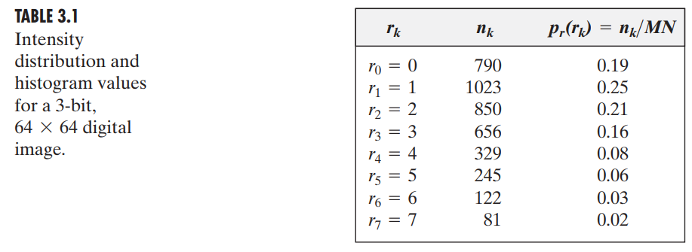

Slide 5
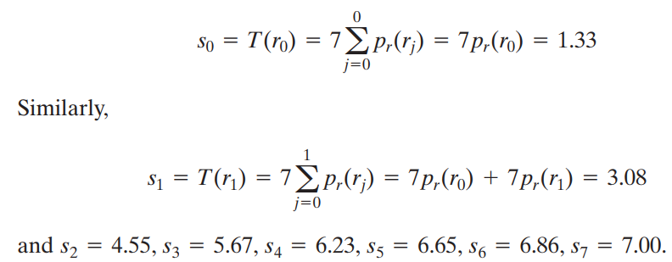

Slide 6
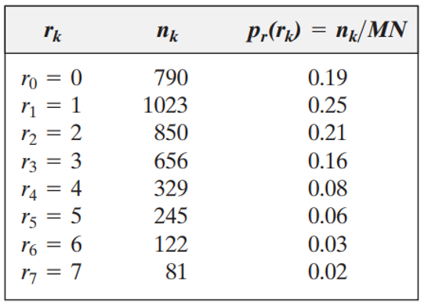
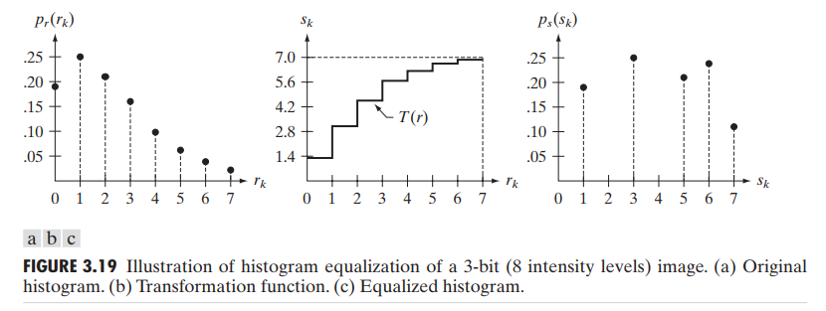
S₀ = 1.33 = 1
S₁ = 3.08 = 3
S₂ = 4.55 = 5
S₃ = 5.67 = 6
S₄ = 6.23 = 6
S₅ = 6.65 = 7
S₆ = 6.86 = 7
S₇ = 7.00 = 7

Slide 7
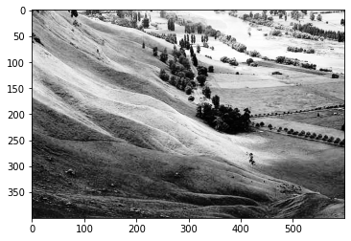
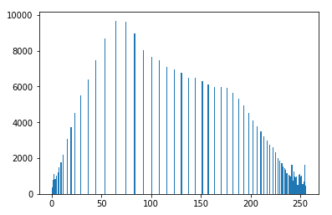
Input Image
Histogram of the Input Image
Equalized Image
Histogram of the Equalized Image

Slide 8
Assignment
Histogram Matching (Specification)
-- using Erlang distribution

Slide 9
Erlang distribution
The Erlang distribution is a two-parameter family of continuous probability distributions
Shape parameter (k) (positive integer)
Rate parameter (λ) (positive real number)
The ‘scale parameter’, µ the reciprocal of the rate parameter
μ = 1/λ.

Slide 10
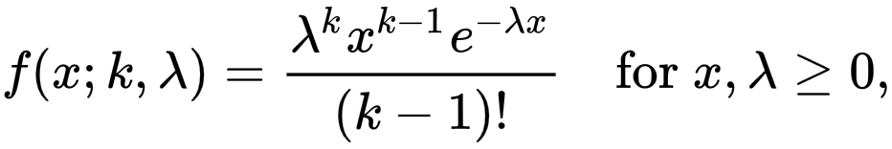
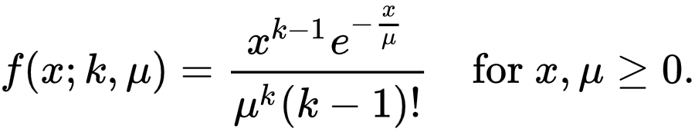

Slide 11
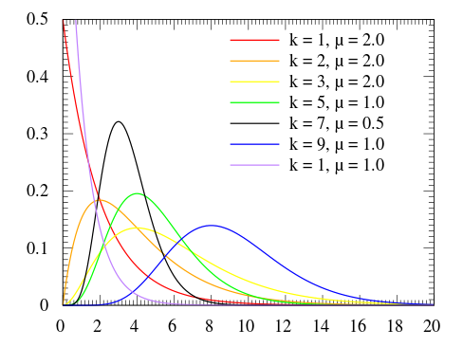

Slide 12
Assignment
Histogram Matching (Specification)
-- using Exponential Function

